Slide 1
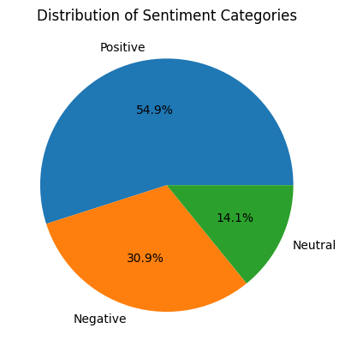
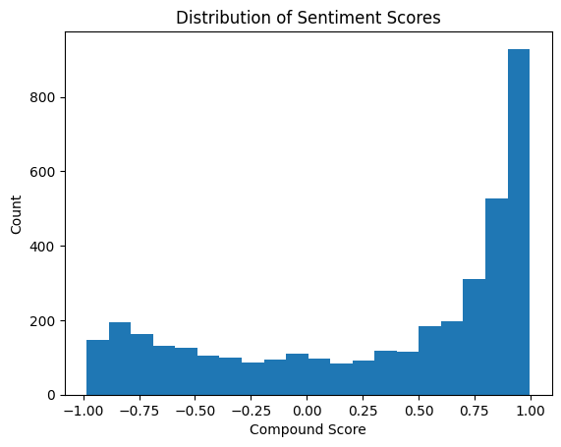
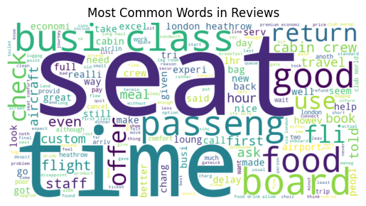
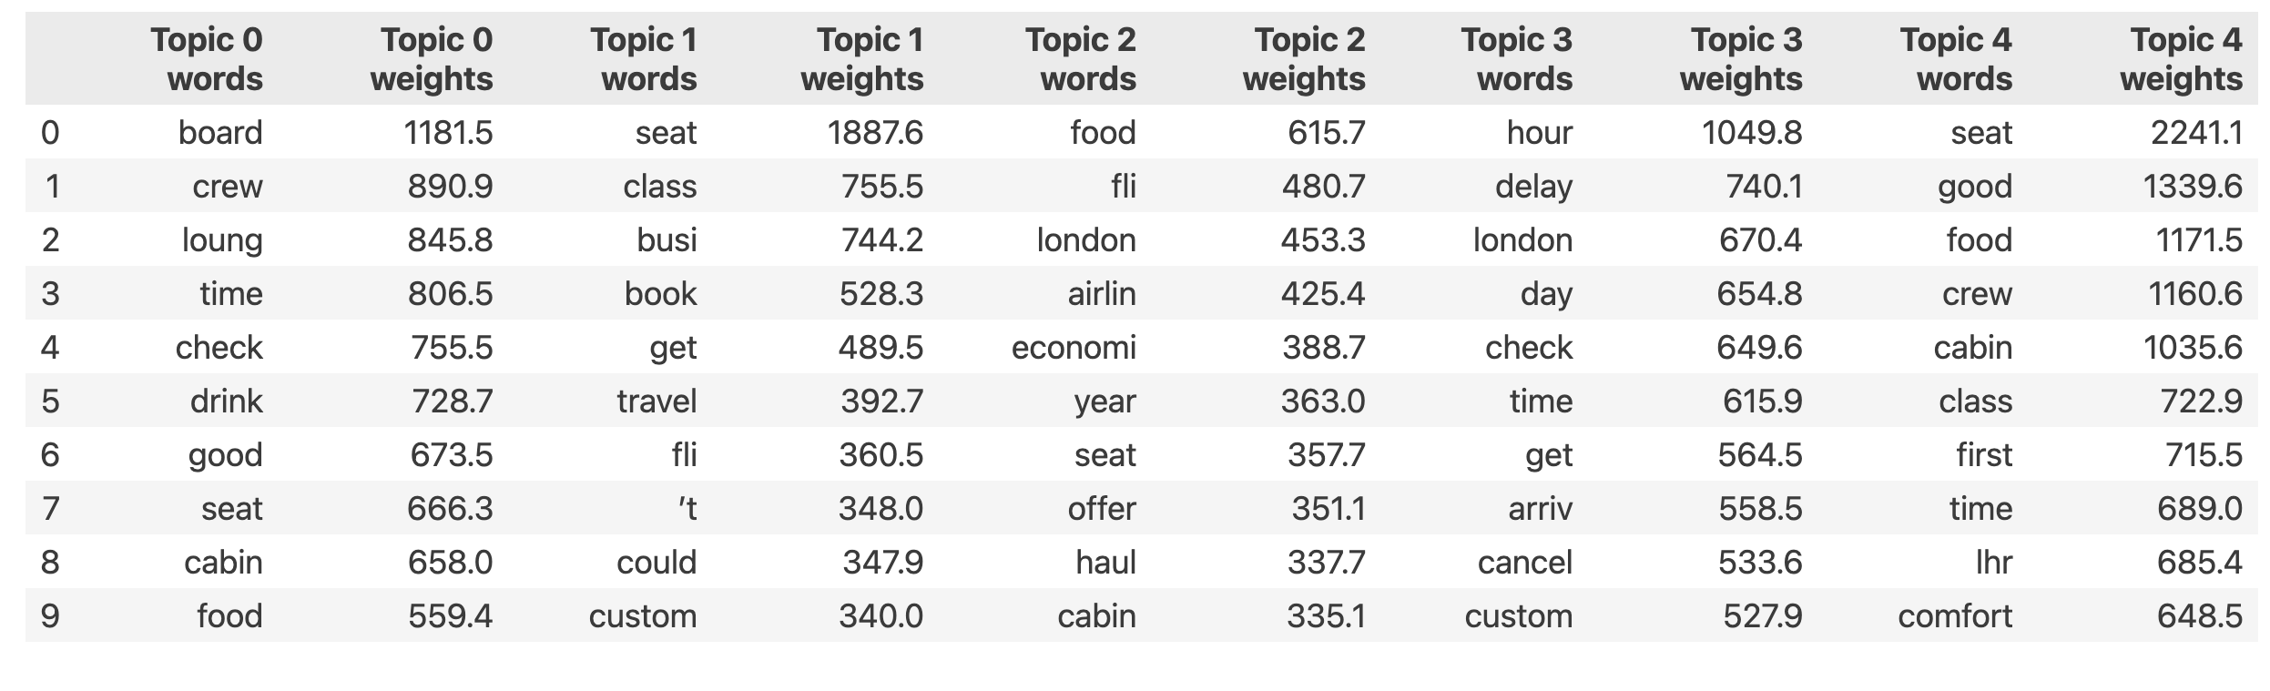
British Airways Customer Experience Analysis
Key Findings
• Overall Positive Experience: 54.9% positive reviews vs 30.9% negative out of 3906 reviews
• Strong positive sentiment clustering (0.75-1.0 range)
• High focus on core service elements: seating, timing, and crew
Critical Insights
• Most discussed: seating, timing, and food service
• Strong correlation between crew service and positive reviews
• Time-related issues dominate negative feedback
Top Discussion Topics
1. Customer Service: crew, staff interactions
2. Flight Experience: seat comfort, food quality
3. Logistics: booking, check-in process
4. Airport Experience: lounges, London facilities
5. Scheduling: flight timing, delays
Recommendations
1. Focus on maintaining high crew service standards
2. Address timing and delay management
3. Enhance seat comfort and food quality
4. Improve airport experience
Notes:
Data Source: SkyTrax Techniques: LDA for topic modeling and Vader for sentiment analysis.

